Slide 1
Digital Portfolio
STUDENT NAME:W.Arokiya uma
REGISTER NO AND NMID: 24bscda002 and asbruapbruap2428b0002
DEPARTMENT: computer science with da
COLLEGE: PPG college of arts and science

Slide 2
PROJECT TITLE
Many students and professionals struggle to present their skills, projects, and contact information in a clear, attractive, and accessible way online. This project aims to create a simple, responsive, and interactive digital portfolio that showcases my background, skills, projects, and contact details effectively.

Slide 3


AGENDA
Problem Statement
Project Overview
End Users
Tools and Technologies
Portfolio design and Layout
Features and Functionality
Results and Screenshots
Conclusion
Github Link
3/21/2024 Annual Review

Slide 4

PROBLEM STATEMENT
The Digital Portfolio is a personal website built to highlight my academic profile, technical skills, and completed projects. It serves as an online resume and portfolio, helping potential employers, clients, and collaborators understand my capabilities and reach me easily.

Slide 5

PROJECT OVERVIEW
Many students and professionals struggle to present their skills, projects, and contact information in a clear, attractive, and accessible way online. This project aims to create a simple, responsive, and interactive digital portfolio that showcases my background, skills, projects, and contact details effectively.

Slide 6

WHO ARE THE END USERS?
Potential employers and recruiters looking for a quick overview of my skills and projects.
College professors and peers interested in my academic and technical work.
Clients or collaborators who want to contact me for projects or internships.
Anyone who wants to learn more about me and my expertise in computer science and data analytics.

Slide 7

TOOLS AND TECHNIQUES
HTML5: Structure and content of the portfolio.
CSS3: Styling, layout, and responsive design.
JavaScript: Interactive features such as skill progress animations, project modal popups, and form validation.
Optional: Image editing tools for project thumbnails and profile picture.

Slide 8
POTFOLIO DESIGN AND LAYOUT
Header: Displays name and navigation links for smooth scrolling to sections.
About Me: Personal introduction with profile photo and summary paragraph.
Skills: Visual progress bars representing proficiency in programming and data analytics tools.
Projects: Grid layout of project cards; clicking a card opens a modal with detailed info.
Contact Form: Allows visitors to send messages with validation to ensure proper input.
Responsive Design: Works well on desktop, tablet, and mobile devices with readable fonts and intuitive navigation.

Slide 9
FEATURES AND FUNCTIONALITY
Smooth navigation: Internal links for easy section access.
Animated skill bars: Progress bars fill dynamically when scrolled into view.
Interactive project cards: Modal popup shows project image, title, and description on click.
Form validation: JavaScript ensures users enter name, valid email, and message before submitting.
Accessible design: Use of semantic HTML, alt attributes for images, and ARIA roles for modal.
Clean UI: Simple color scheme and readable typography for professional look.

Slide 10
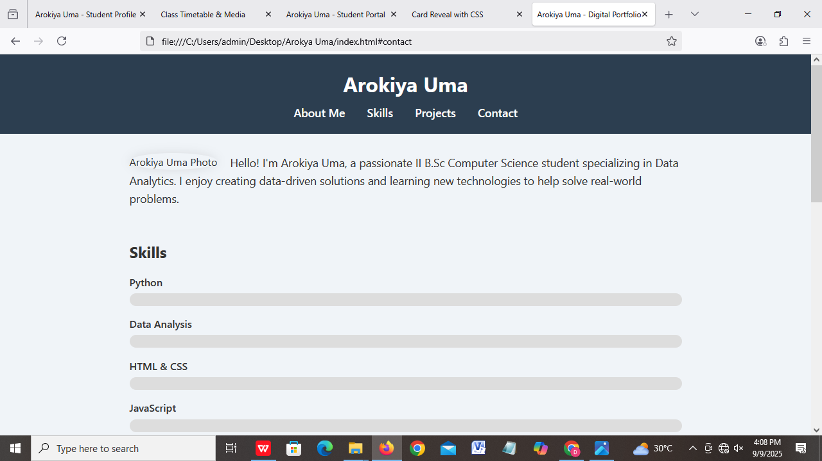

RESULTS AND SCREENSHOTS
3/21/2024 Annual Review

Slide 11
CONCLUSION
This was done by me the Digital Portfolio successfully demonstrates my technical skills and projects while providing a user-friendly experience. It can be expanded in the future to include a blog, downloadable resume, or integrations with social media and GitHub. Overall, it serves as a professional online presence that helps me connect with opportunities and showcase my work effectively.

